Slide 1


UAPB/AM&N
Alumni Center Campaign
Partners Program 2023
Notes:
ID=d924773e-9a16-4d6d-9803-8cb819e99682
Recipe=text_billboard
Type=TextOnly
Variant=0
FamilyID=AccentBoxWalbaum_Zero

Slide 2

Introduction
The UAPB/AM&N National Alumni Association has a monumental task of raising $2.8 million for the building of a National Alumni Center. However, with the large base of alumni and friends of the university, the goal of raising $2.8 million is obtainable.

Slide 3

Partners Program
The UAPB/AM&N Alumni Center Partners Program was created to increase the number of alumni and friends of the university to assist with our fundraising efforts by calling alumni and friends seeking donations and recruiting individuals to do the same. The Partners Program utilizes principles of marketing models that have proven effective in raising significant amounts of money by increasing the base of participants involved in the fundraising process. The Partners Program provides an incentive and recognition to motivate individuals to participate in the fundraising campaign.

Slide 4
1. A Partner is an individual that will commit to donating a minimum of $300 or more towards the Alumni Center Campaign and agree to recruit others to become a partner. Chapters can also become a partner when its leadership agrees to make a chapter donation of $300 or more towards the Alumni Center Campaign and agrees to encourage its members to become partners.
2. A Partner will receive a 10% credit on all funds raised directly and a 10% credit on the donation given by a recruited partner. In addition, a partner will receive a 5% credit for all funds raised by the recruited partner’s recruit. The Partner's Program is a two-level incentive plan.
The Partners Program

Slide 5
3. Credits from the Partners Program will be applied towards the various recognition levels at the end of the Alumni Center Campaign.
4. Alumni Chapters that register to become partners will receive 10% credits on all donations made to the Alumni Center by its members. When the chapter signs up, a chapter link for the program will be established and provided. Chapters should encourage members to use the chapter partners’ donation link to receive credit for their donations. In addition, chapters can earn 5% credit on all verified funds raised by its members in the partners’ program.
The Partners Program

Slide 6
5. Partners who recruit three or more partners and meet the requirement of donating $300 or more will be titled Certified Partners and listed on the Wall of Honor inside the Alumni Center.
6. The Partners Program will be retroactive to the initial launch of the Partners Program. All partners who signed up during the initial launch of the partners' program and new partners will receive credit for verified donations. Only one person can receive credit for a donation.
The Partners Program

Slide 7
For this program to operate as efficiently as possible, we ask all partners to follow the following guidelines and recruit, recruit, recruit.
If you have a list of names, you will be calling, please provide those names and numbers to the Alumni Center Calling Committee via email to staphea@yahoo.com to minimize duplication of calling people.
If partners do not have a list of individuals to call, a list will be provided by the Alumni Center Calling Committee.
To sign up for the Partners Program, please contact Staphea Campbell at staphea@yahoo.com or your chapter representative.
Partners Program Guidelines

Slide 8
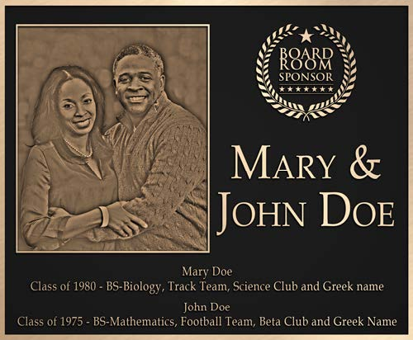
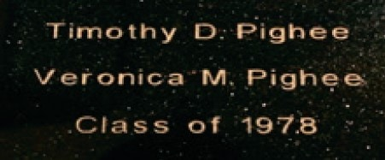
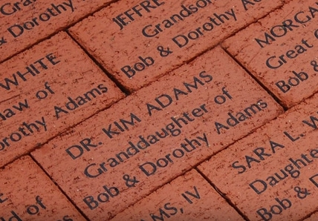
Campaign Giving Opportunities
Wall Plaques:
Platinum Gold Silver
$10,000 $5,000 $2,500
Engraved Floor Tile
$1,000
Engraved Brick
$500

Slide 9
Partners Program Chart
This is YOU
Recruited Partner 1
10% Credit
Recruited Partner 2
10% Credit
Recruited Partner 3
10% Credit
Recruited Partner 1A 5% Credit
Recruited Partner 1B
5% Credit
Recruited Partner 1C
5% Credit
Recruited Partner 2A 5% Credit
Recruited Partner 2B 5% Credit
Recruited Partner 2C 5% Credit
Recruited Partner 3A
5% Credit
Recruited Partner 3B
5% Credit
Recruited Partner 3C
5% Credit

Slide 10



Thank you
Dr. Larry Cooper, Co-Chair
Phillip Williams, Co-Chair
partnersprogram@uapbalumni.org
www.uapbalumni.org

